Slide 1
Responsive Web Design
Introduction Responsive Web Design
Notes:
Add instructor notes here.

Slide 2
Lesson Objectives
1.1: Introduction to Responsive Web Design
1.2: History of RWD
1.3: Why RWD
1.4: Advantages of RWD
1.5: Components of RWD
Notes:
Add instructor notes here.

Slide 3
1.1: Introduction Responsive Web Design
It is a concept of developing a website in a special way to allow the layout to adjust according to the user’s screen resolution
This can be done using media queries
When you view a web site on a laptop or a tablet or a smart phone then the web site should be able to show appropriate contents without cutting any contents.
It should manage the contents as per size of display unit
Notes:
Add instructor notes here.

Slide 4
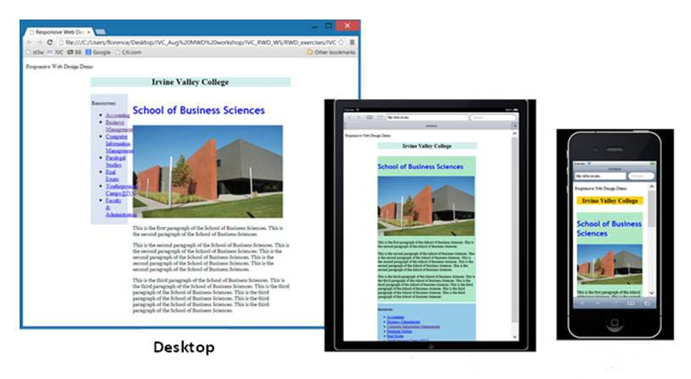
1.1: Introduction Responsive Web Design
A design when the layout and content adapts to the user’s devices: screen size, platform and orientation
The website that have the technology to automatically respond to the user’s preferences
Tablets
Smart phones
Notes:
TDD in its simplest form is just this:
Write your tests
Watch them fail
Make them pass
Refactor
Repeat
Add instructor notes here.

Slide 5
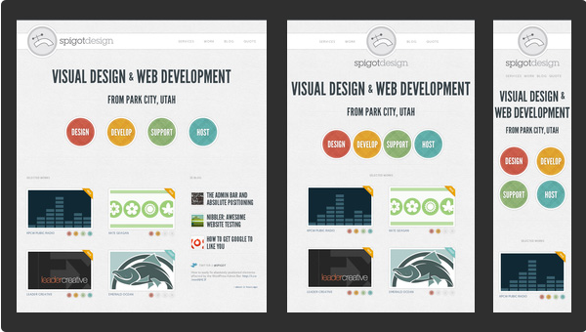
1.1: Introduction Example
Notes:
Add instructor notes here.

Slide 6
1.2: History History of RWD
Ethan Marcotte first coined the term Responsive Web Design in his article
He defined the technique of RWD by using fluid grids, flexible images and media queries
This provides different visual experience for different screen sizes
Notes:
Add instructor notes here.

Slide 7
1.3: RWD Why RWD
New devices are pouring into the market, responsive web design let us build one site, and modify it to adapt the new device’s screen size
Build once for all devices
If we have a working website:
No need to rebuild new websites to adapt the new devices
We can convert the existing working website to a responsive Web site to adapt all kind of devices
Notes:
Add instructor notes here.

Slide 8
1.4: Advantages of RWD Advantages of RWD
One single HTML document to be maintained
One single CSS file to be maintained
The site is easily accessible on any type of device.
Better user experience.
Users will have a similar experience using the site when they access the site from different devices.
Responsive Web is flexible and adaptable
Maintaining a RWD is:
Easier than maintaining several website for different devices
Notes:
Add instructor notes here.

Slide 9
1.5: Components of RWD Components of RWD
Three core components of Responsive Web Design are:
flexible, grid-based layout - The web sites are built using percentage for the widths
Flexible images and media – When screen size begins to change, the media/images need to be flexible to suit the screen size
Media queries, a module from the CSS3 specification
They help in creating a more flexible, more responsive approach to designing for the web
we’ll have created a design that can adapt to the constraints of the browser window or device that renders it, creating a design that almost responds to the user’s needs.
Notes:
Add instructor notes here.

Slide 10
Summary
A design when the layout and content adapts to the user’s devices: screen size, platform and orientation
Build once for all devices
components of RWD
flexible, grid-based layout
Flexible images and media
Media queries
Notes:
Add the notes here.
Add instructor notes here.

